Slide 1
Welcome to React the Definitive Beginner’s Guide
Rami Sayar
Jeremy Foster

Slide 2
Agenda - list all main modules
1
Welcome to React – the Definitive Beginner’s Guide
2
Introduction to Components
3
Handling Data and State with React
4
More React with Routers and Other Add-ons
5
ES2015 with React, Webpack, and Other Tools
6
Connecting Pizza Box App with the Backend

Slide 3
Module 3: Handling Data and State with React
Rami Sayar
Jeremy Foster

Slide 4
What is state?

Slide 5
Passing data to a component with props

Slide 6
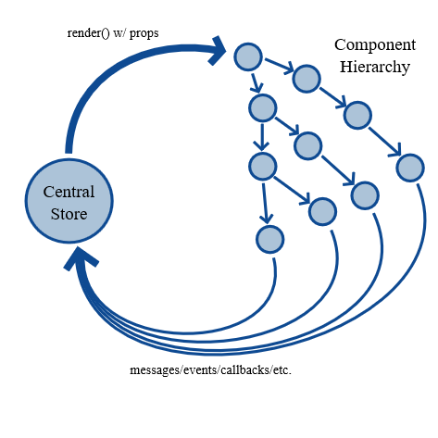
React’s one-way data flow and data binding

Slide 7
What components should have state?

Slide 8
Designing the data model

Slide 9
Building the second big React component in the bot app

Slide 10
Handling events with event listeners

Slide 11
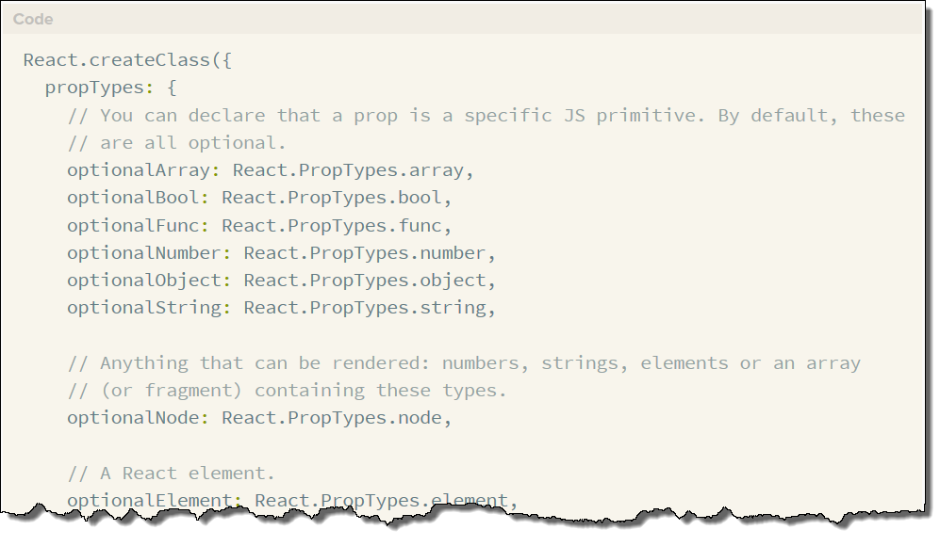
Component validation with proptypes

Slide 12
Building the last React component in the bot app

